Slide 1


Bioinformatics Summer School
Long-reads Transcriptomics
Ana Conesa
Spanish National Research Council, ES
LongTREC - The Long-reads TRanscriptome European Consortium
Marie Skłodowska-Curie grant agreement No 101072892

Slide 2
Course Contents
1
How to create your data matrix
2
Basic concepts for differential expression
3
tappAS
4
HandsON

Slide 3
Section 1
How to create your data matrix
Join and Call vs Call and Join

Slide 4
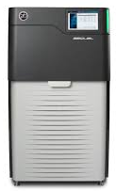
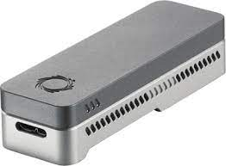

How to create your expression data matrix?
Samples
RNA
LR Sequencing
Reads
Reads
Reads

Slide 5
The Join and Call Approach
Samples
RNA
LR Sequencing
Reads
Your favorite Transcript reconstruction tool
Reads
Transcript
models
Reads

Slide 6
The Join and Call Approach
Samples
RNA
LR Sequencing
Reads
Your favorite Transcript reconstruction tool
Curated and
annotated
Transcriptome
gtf/gff
Reads
Transcript
models
Reads

Slide 7
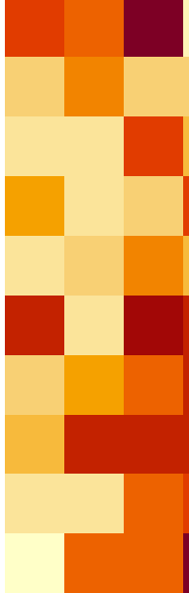
The Join and Call Approach
Samples
RNA
LR Sequencing
Reads
Your favorite Transcript reconstruction tool
Curated and
annotated
Transcriptome
gtf/gff
Reads
Transcript
models
Reads
Expression
matrix
Curated and
annotated
Transcriptome
gtf
Reads
+
Reads
map
assign
Reads

Slide 8
The Call and Join Approach
Samples
RNA
LR Sequencing
Transcript
models
Reads
Transcript
models
Reads
Reads
Transcript
models

Slide 9
The Call and Join Approach
Expression
matrix
Samples
RNA
LR Sequencing
Transcript
models
Reads
Merged
transcriptome
+
Transcript
models
Reads
Reads
Transcript
models

Slide 10
The Call and Join Approach
Samples
RNA
LR Sequencing
Expression matrix
Transcript
models
Reads
Merged
transcriptome
+
Transcript
models
Reads
Reads
Transcript
models
Expression matrix
of curated transcriptome
Curated and
annotated
Transcriptome
gtf/gff
+

Slide 11
How the two approaches may compare?
Criteria | Join and Call | Call and Join
Sensitivity to detect transcripts
Memory needs
Easiness to scale up

Slide 12
How the two approaches may compare?
Criteria | Join and Call | Call and Join
Sensitivity to detect transcripts | Higher | Lower
Memory needs
Easiness to scale up

Slide 13
How the two approaches may compare?
Criteria | Join and Call | Call and Join
Sensitivity to detect transcripts | Higher | Lower
Memory needs | Higher | Lower
Easiness to scale up

Slide 14
How the two approaches may compare?
Criteria | Join and Call | Call and Join
Sensitivity to detect transcripts | Higher | Lower
Memory needs | Higher | Lower
Easiness to scale up | Lower | Higher

Slide 15
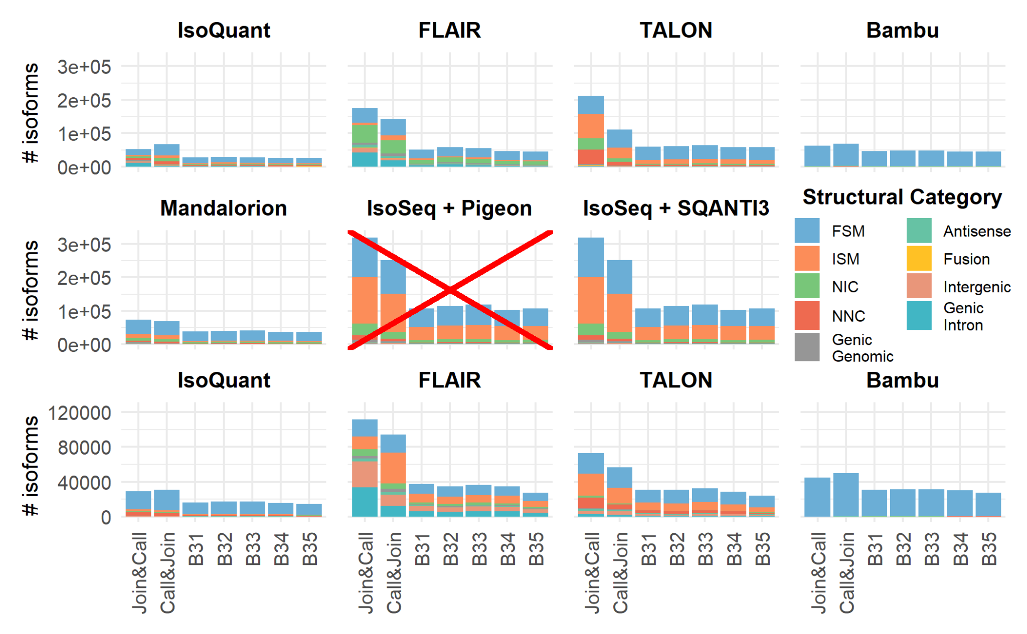
Comparing Join&Call vs. Call&Join
Number of isoforms identified by Join&Call, Call&Join and individual Mouse brain samples
Results depend of the algorithm, with some of the loosing isoforms with more data

Slide 16
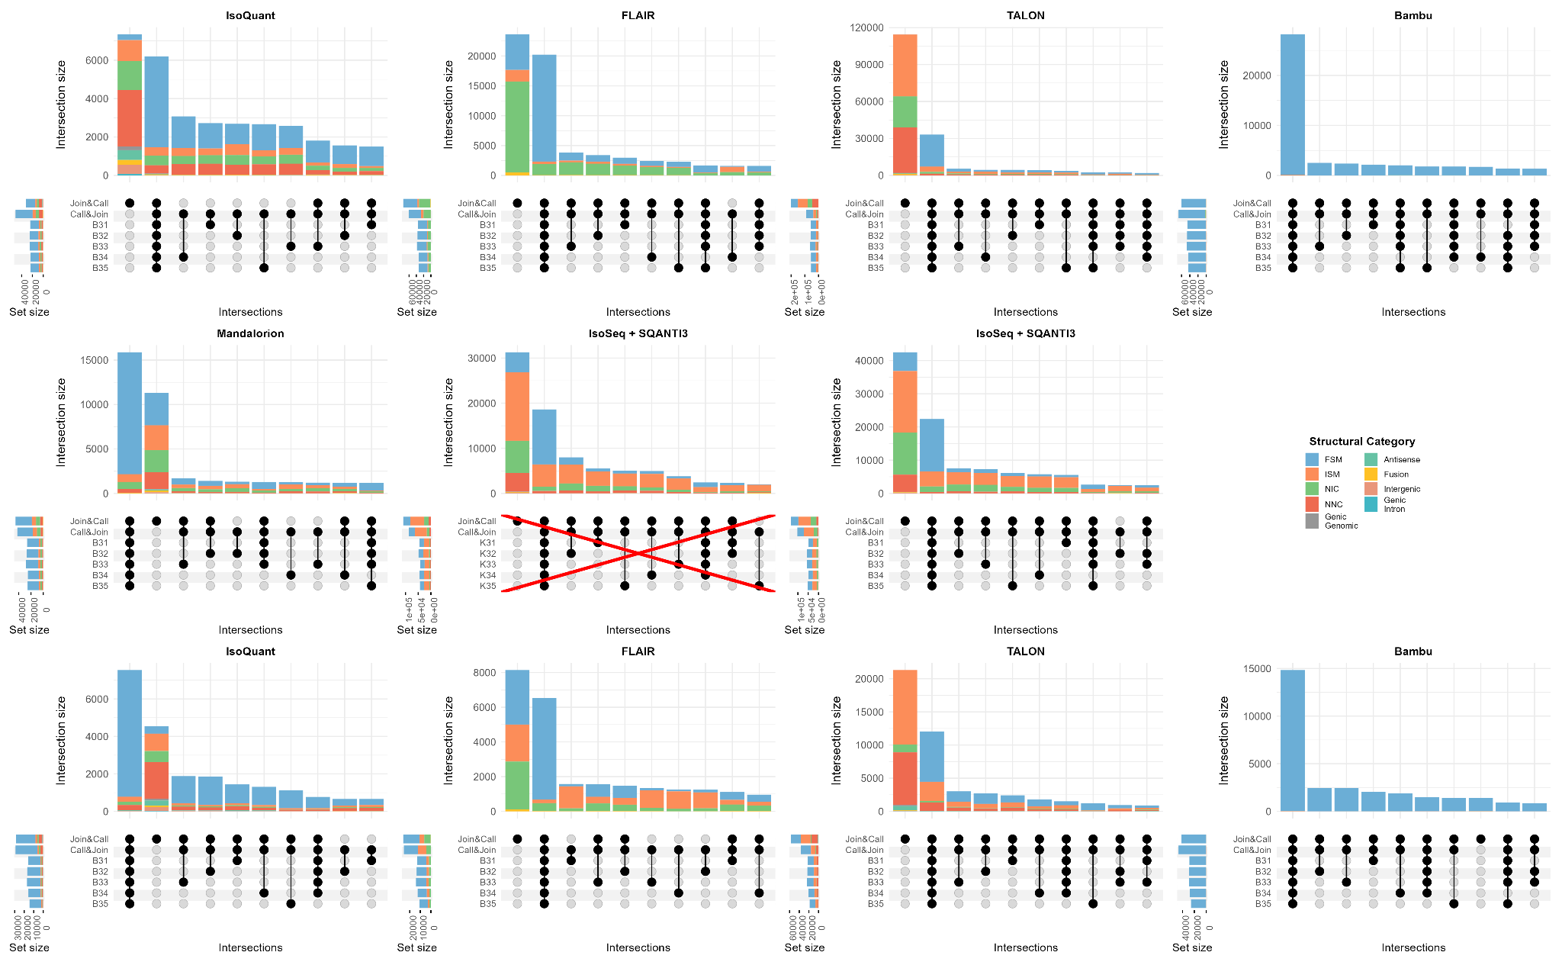
Comparing Join&Call vs. Call&Join
Join and Call transcripts are basically novel (low expresssion)
Most known transcripts are either identified in all samples or in one sample.
Interested in novel transcripts? → Join and Call (max sensitivity)
Not interested in novel transcripts? → Call and Join (consistent transcriptional signal)

Slide 17
Checking your knowledge
You are analyzing 400 patient samples that will be arriving to your lab during the next year. The objective is to find robust markers of disease. Which approach will you use?
1
You are planning to use long-reads for genome annotation of a butterfly. You are getting samples from 3 different species and 5 different tissues to obtain a good coverage of the transcriptome space. Which approach will you use?
2

Slide 18
Section 2
Basic concepts for differential expression
Functional Diversity,
Differential Expression, Differential Isoform Usage

Slide 19
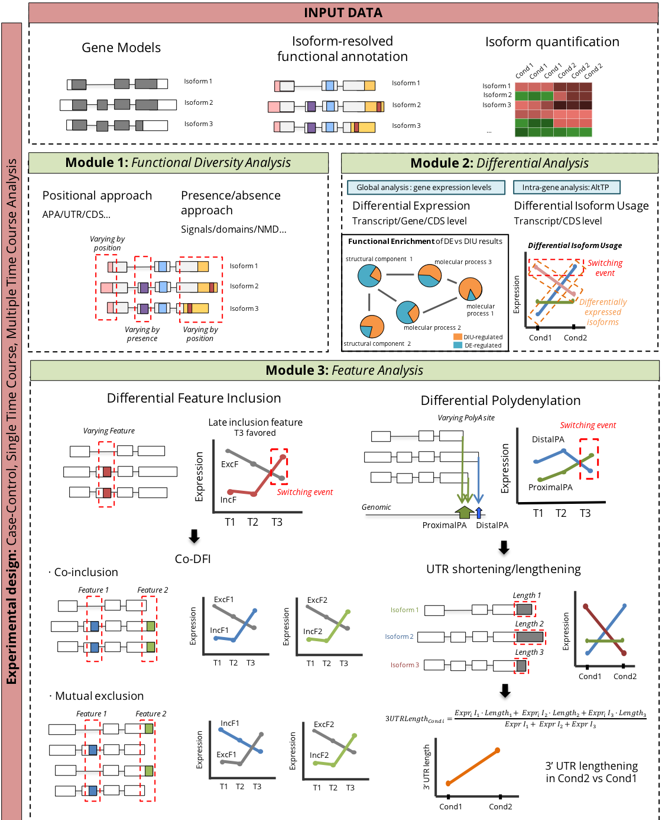
What input data do we need to functional isotranscriptomics analysis?

Slide 20
What kind of questions can we ask to the data?

Slide 21
What kind of questions can we ask to the data?
Differential gene expression (DGE): Sum of all expressed transcripts/gene for global differences
Differential transcript expresión (DTE): Each transcript evaluated idependently
Differential isoform usage (DIU): Chanes in the relative expression of different isoforms

Slide 22
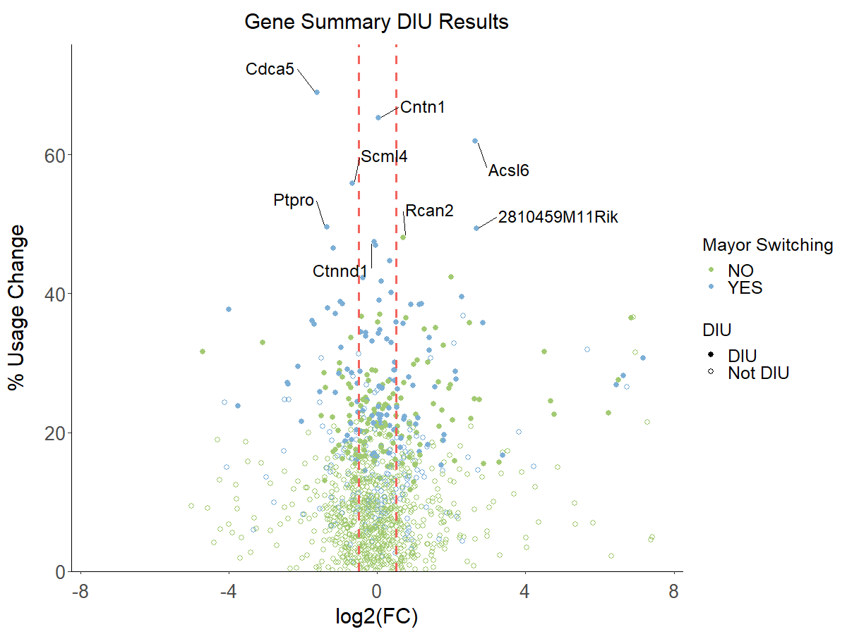
What kind of questions can we ask to the data?
Differential gene expression (DGE): Sum of all expressed transcripts/gene for global differences
Differential transcript expresión (DTE): Each transcript evaluated idependently
Differential isoform usage (DIU): Chanes in the relative expression of different isoforms

Slide 23
What kind of questions can we ask to the data?

Slide 24
Checking your knowledge
Assing: DGE, DTE, DIU, Isoform switching
a
b
a
b
a
b
a
b
DGE
DTE
DTE
DIU
Switching
DGE
DTE
DIU
DGE
DTE (only blue)
DIU
Switching

Slide 25
Section 3
tappAS
Join and Call vs Call and Join

Slide 26
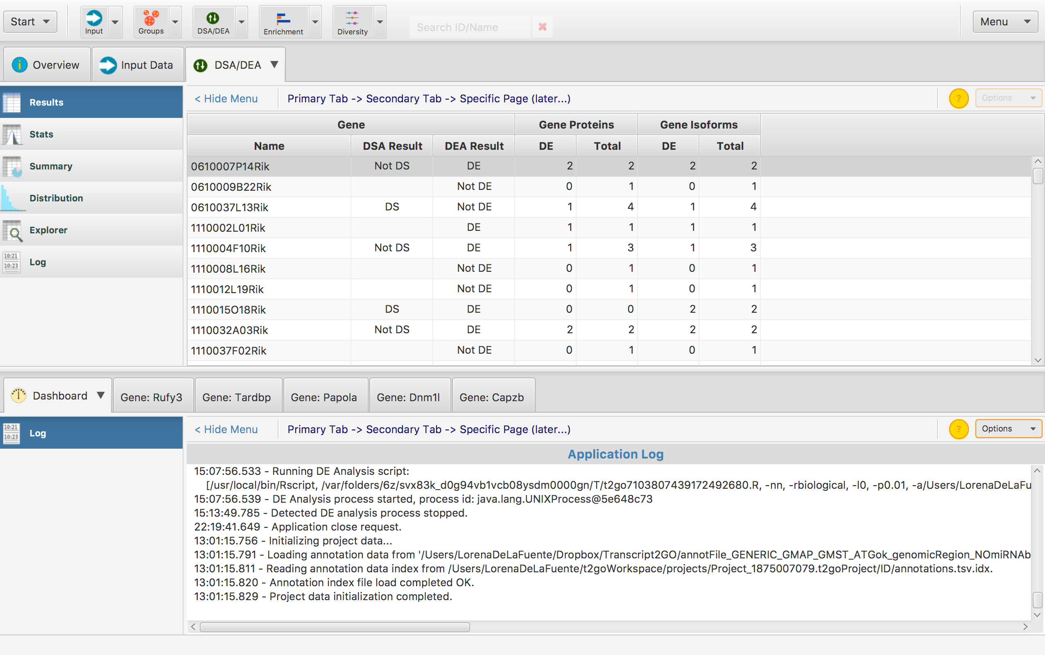
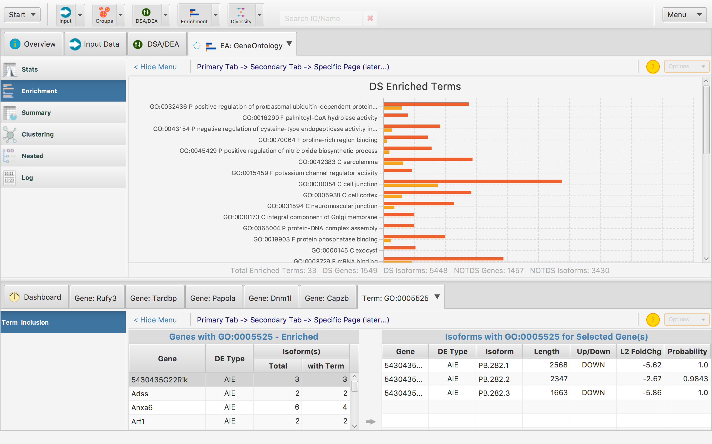
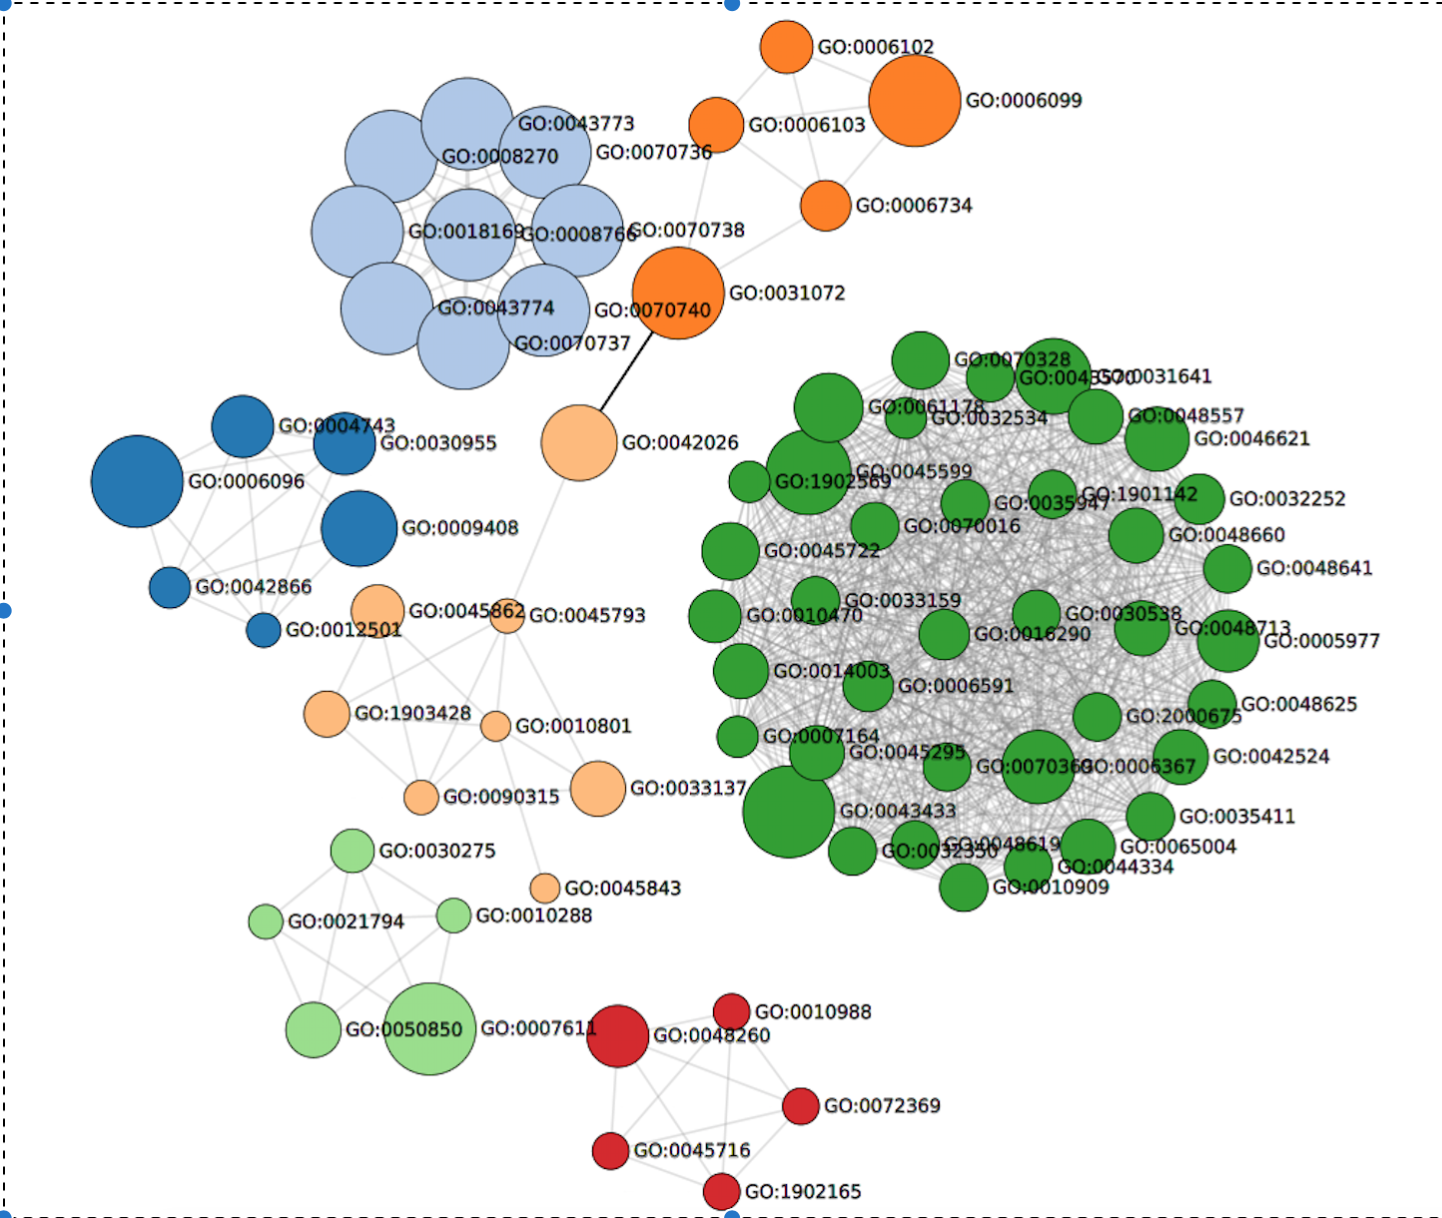
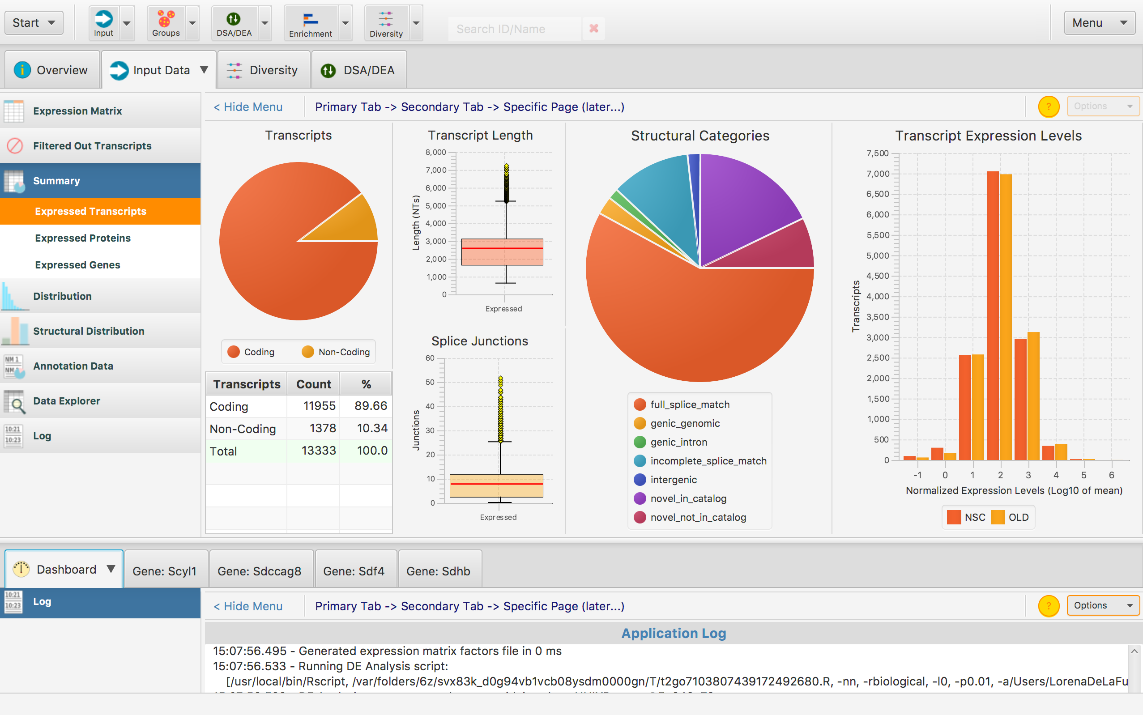
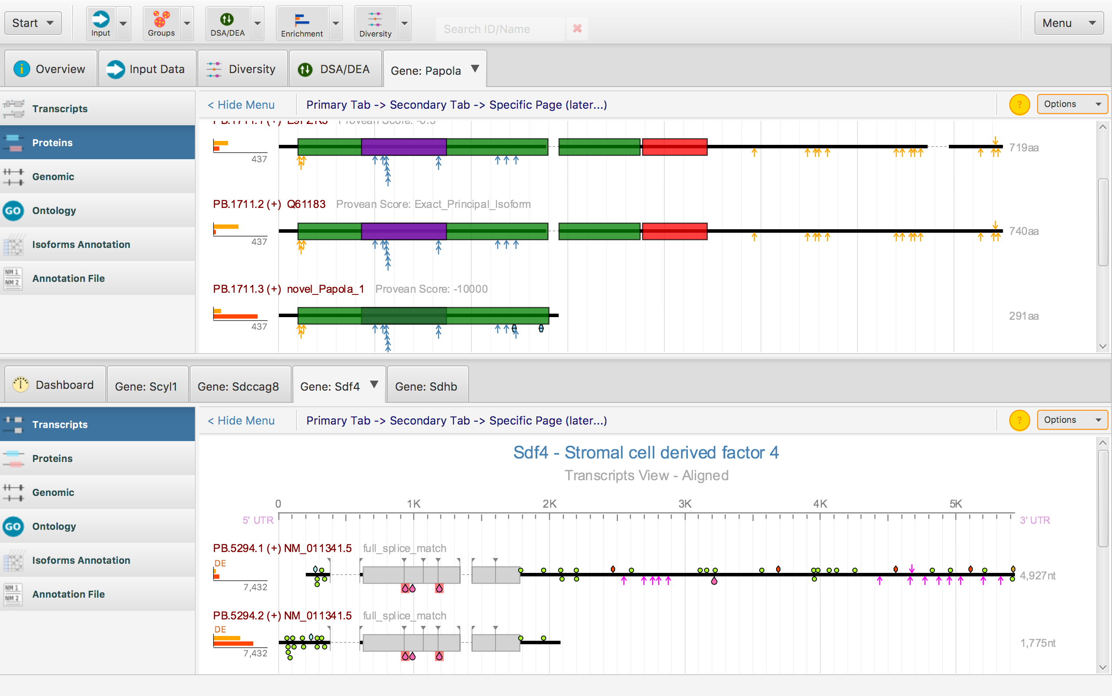
The tappAS application

Slide 27
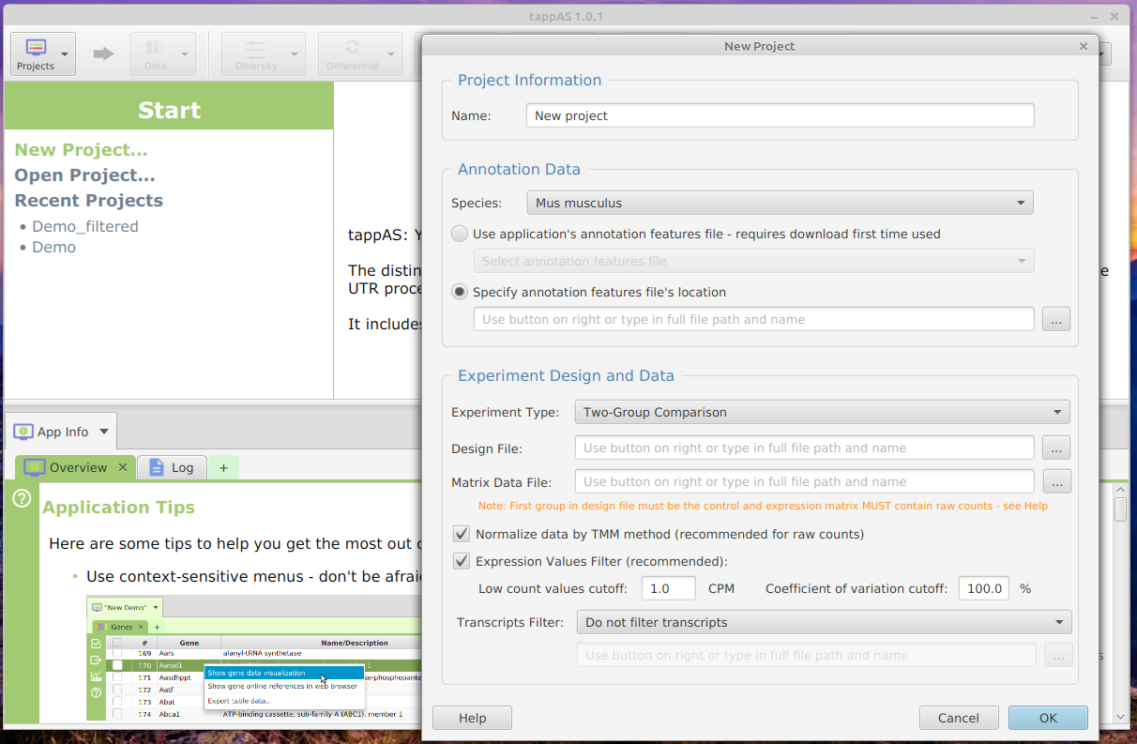
Project creation interface
1. Supply a name for the project
Built-in
2. Select functional annotation
Custom
3. Design type and file
Two-group comparison
Single time course
Multiple time course
4. Expression matrix file
5. Normalization and filtering options

Slide 28
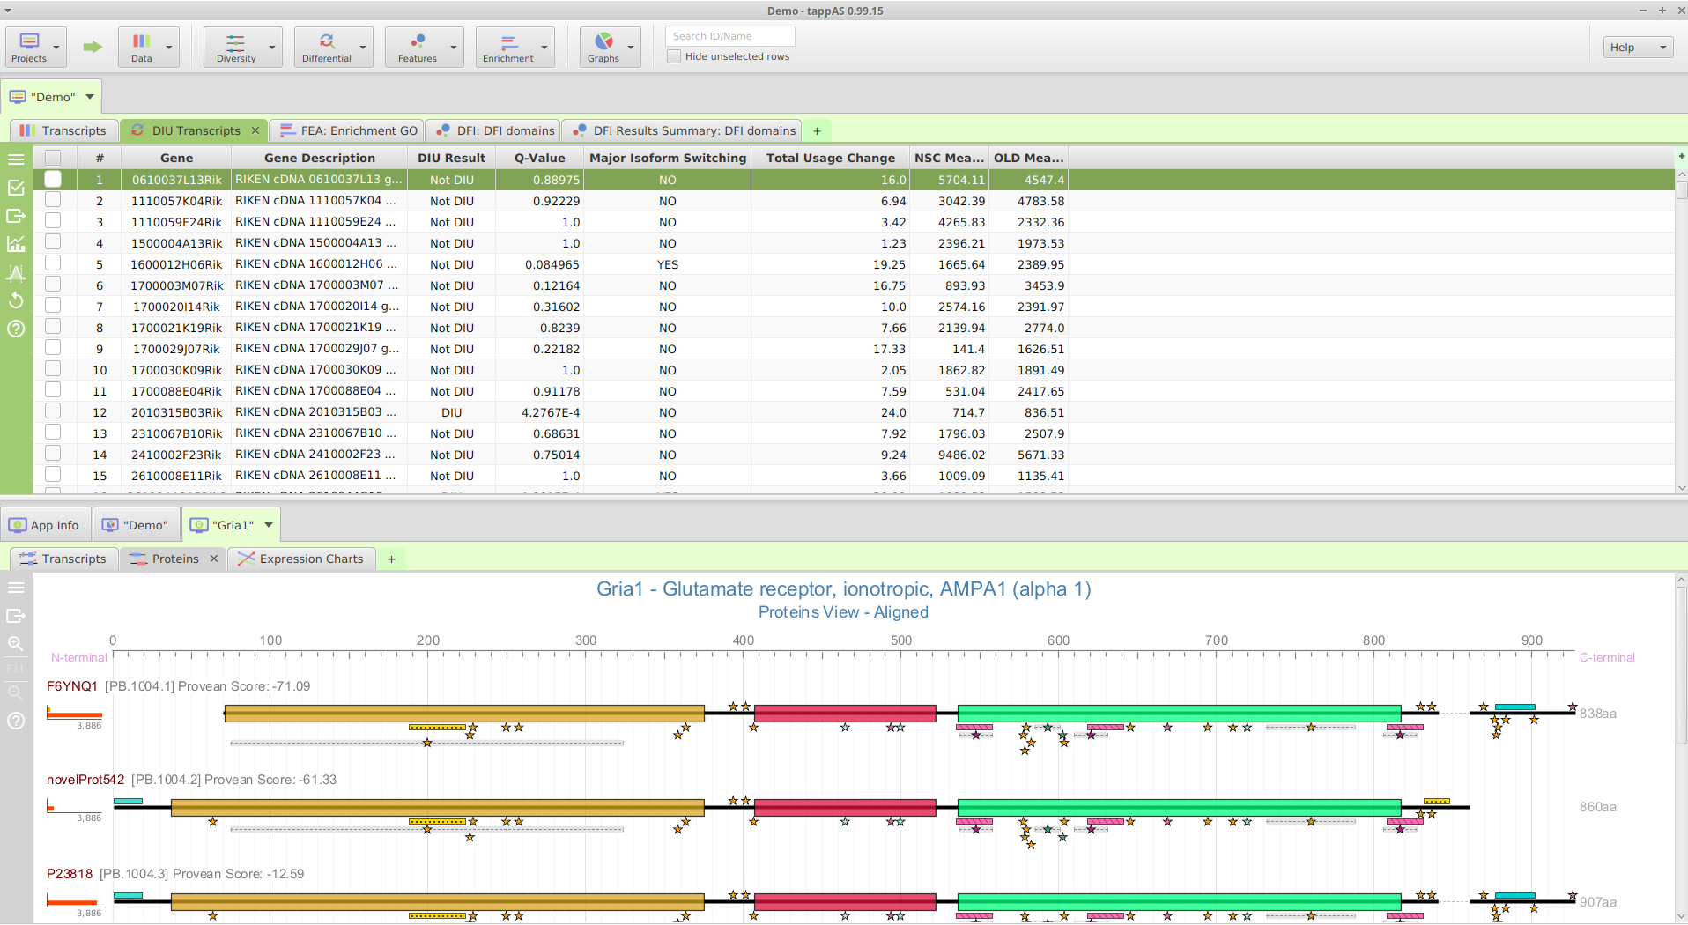
tappAS interface
Control panel (top bar)
Data and result tables panel (top panel)
Visualization panel (bottom panel)

Slide 29
tappAS interface
Run analyses and view results
Search bar for data and results panel
Create new and view extant projects
Control panel (top bar)

Slide 30
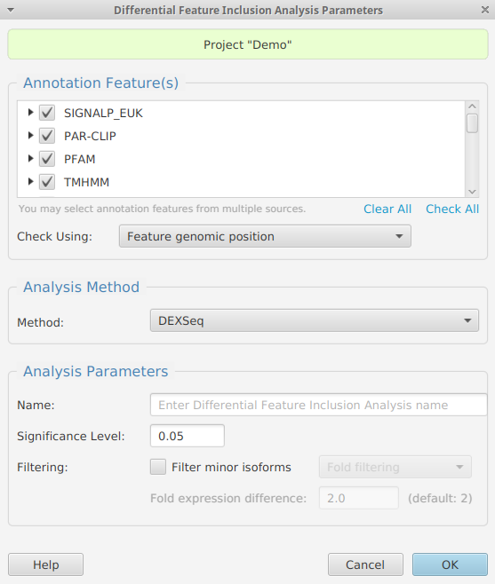
tappAS interface
Run analyses and view results
Control panel (top bar)
Analysis pre-run window to select parameters
Analysis info and help (built-in documentation)

Slide 31
tappAS interface
Result subtabs for multiple analyses
Multi-option side bar
Data and result tables panel
Analysis log
Filter table
Export table
Visualization options
Change significance level
Re-run analysis
Help
Analysis result table
Contains expression matrices for genes, transcripts and CDS, analysis result tables and result summary tables for up to 3 projects simultaneously.

Slide 32
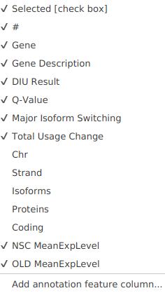
tappAS interface
Result subtabs for multiple analyses
Table column customization
Multi-option side bar
Data and result tables panel
Analysis log
Filter table
Export table
Visualization options
Change significance level
Re-run analysis
Help
Analysis result table
Contains expression matrices for genes, transcripts and CDS, analysis result tables and result summary tables for up to 3 projects simultaneously.

Slide 33
tappAS interface
Analysis-specific visualization options
Visualization subtabs: result-specific graphics
Gene-level visualization
Multi-option side bar
Visualization panel
Analysis log
Export image
Zoom/adjust to screen.
Help.
Contains gene-level visualization and result summary visualizations for the project under the project name subtab (e.g. Demo).

Slide 34
tappAS interface
More built-in documentation access points

Slide 35
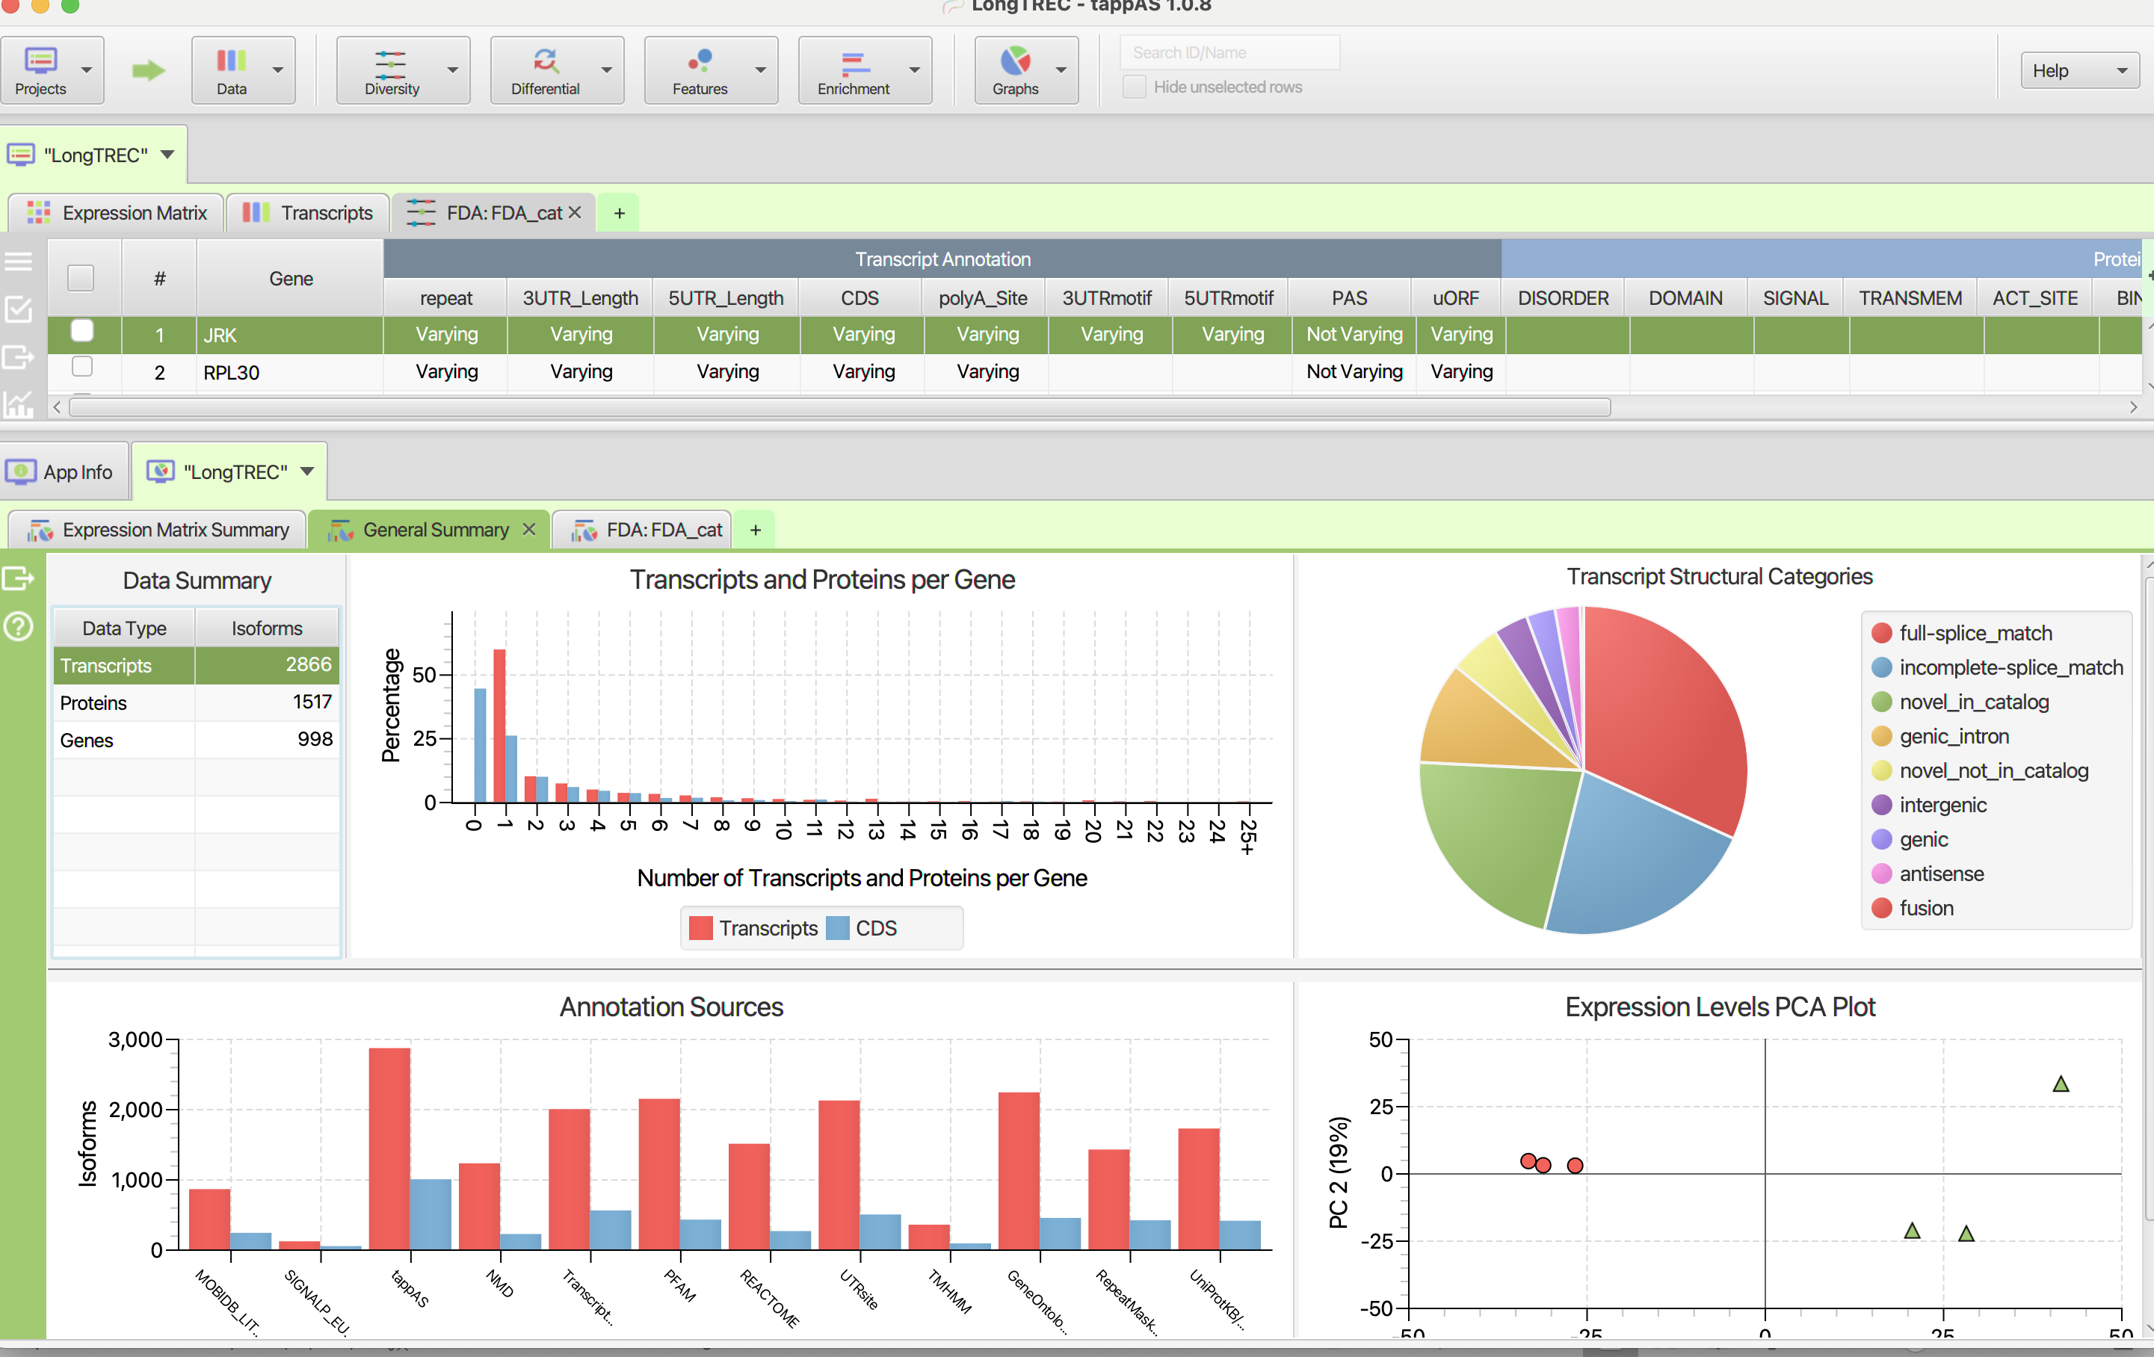
Some results screen-shots: General Summary

Slide 36
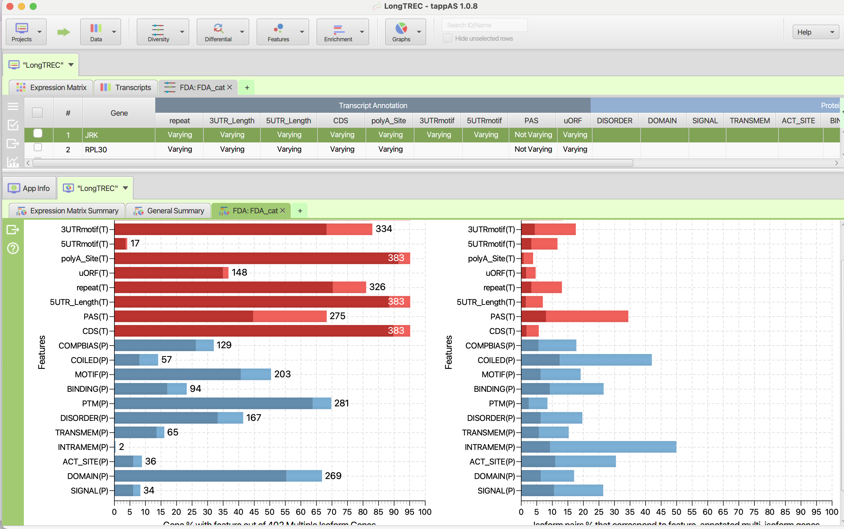
Some results screen-shots: Diversity Analysis + Visualization

Slide 37
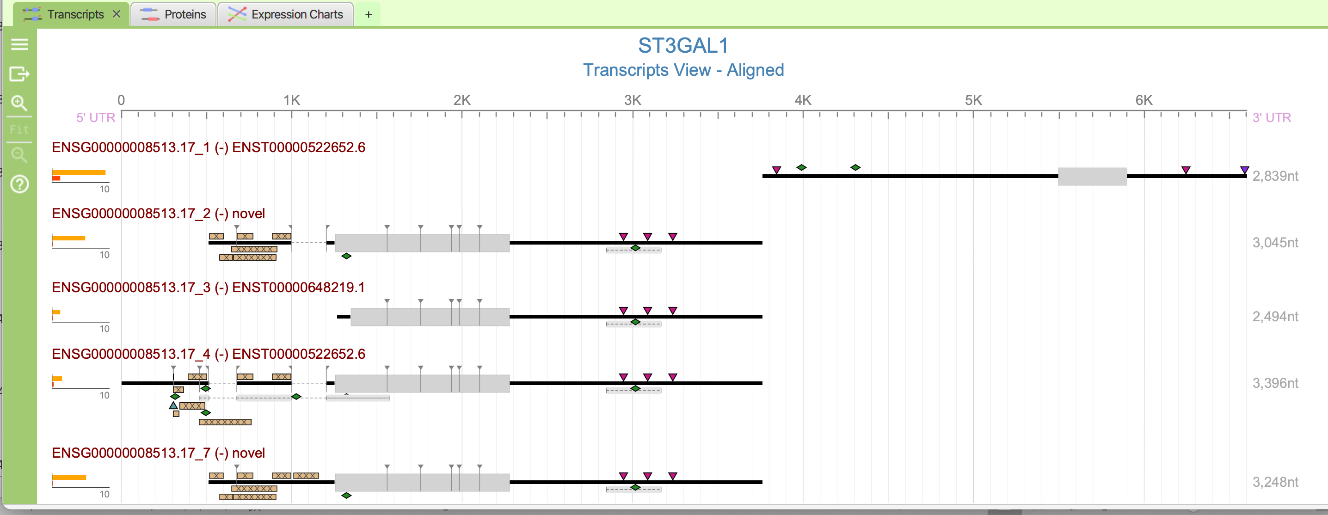
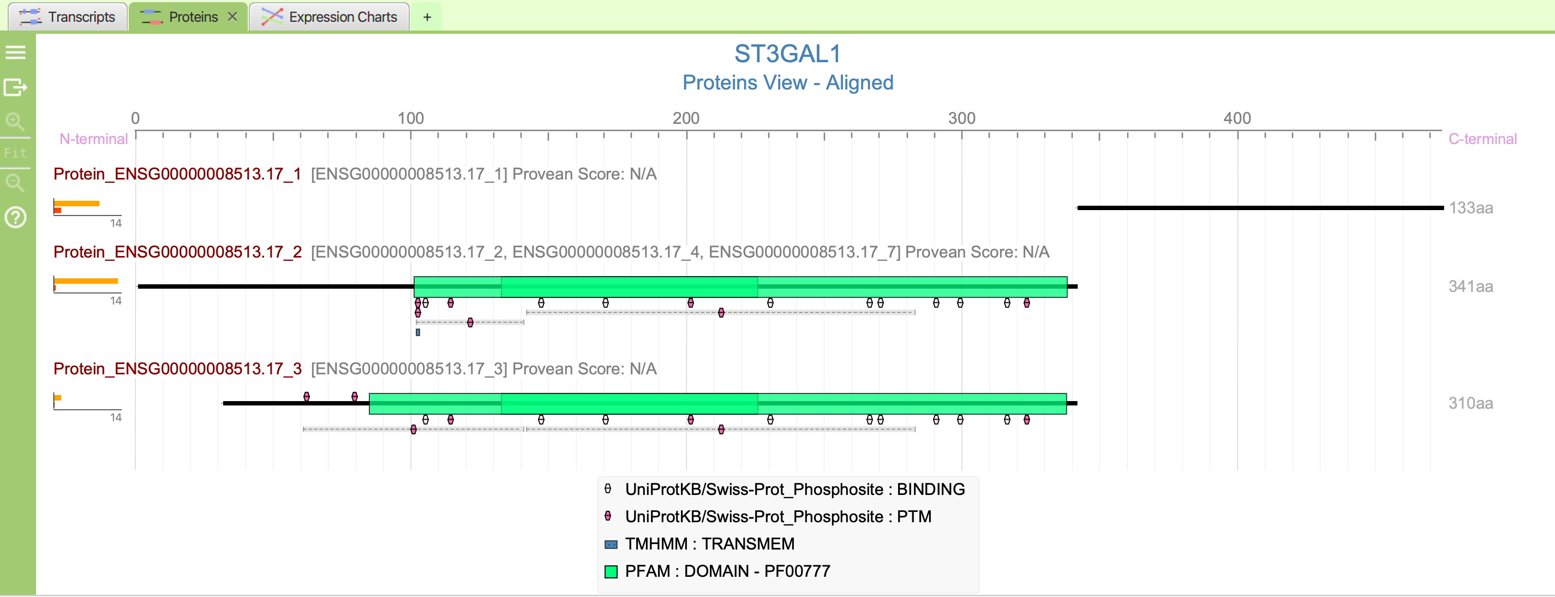
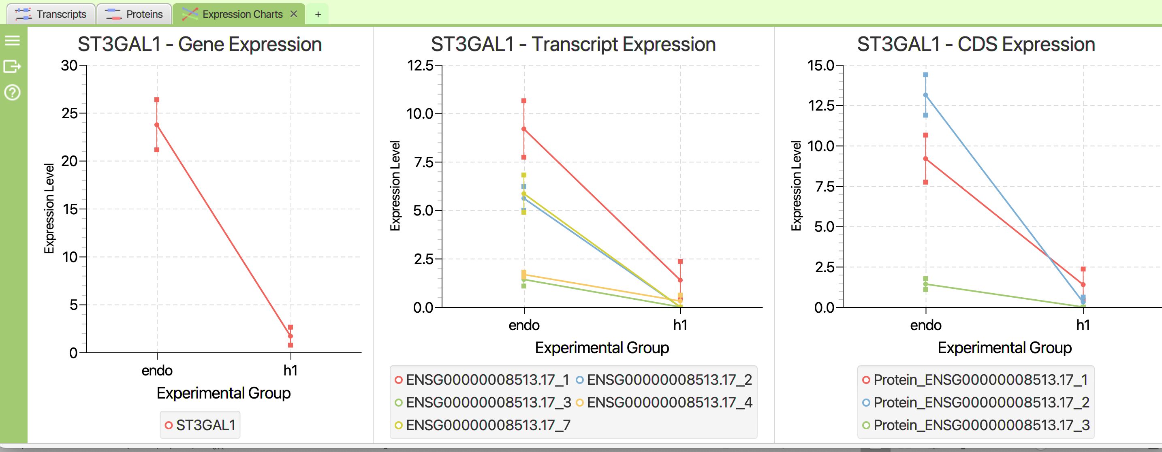
Some results screen-shots: Browse specific genes

Slide 38
Section 4
HandsON
tappAS

Slide 39
tappAS Hands-on
Analysis of isoform differences between LRGASP datasets : H1 vs Endoderm cell types
DATA
annotation: /home/train/longTREC/day2/sqanti3/data/h1_endo_chr8_isotools_isoannot_collapsed.gff3
design: /home/train/longTREC/day2/sqanti3/data/exp_design.txt
matrix: /home/train/longTREC/day2/sqanti3/data/h1_endo_chr8_all_count_tappas.txt

Slide 40
tappAS Hands-on
Analysis of isoform differences between LRGASP datasets : H1 vs Endoderm cell types
TASKS
Create a new project and Explore the data
1) Browse the data for one selected gene of your choice. How many isoforms? Which annotations?
2) How many genes and proteins in the project?
3) Which functional annotation types are represented?
4) Is there evidence of transcriptional differences between cell types?
* Perform Functional Diversity Analysis
1) Which annotation type is most diverse at the protein and RNA levels?
2) Identify a varying gene at the table and browse the transcript/protein view to confirm the
variations
2) Evaluate isoform annotation differences at the ID level for PFAM domains and UTR sites

Slide 41
tappAS Hands-on
Analysis of isoform differences between LRGASP datasets : H1 vs Endoderm cell types
TASKS
Perform differential isoform usage
1) How many genes with DIU and how many have a isoform switch
2) Choose a gene with a switching evento and look for the switched isoforms?
3) Do the switched isoforms contain different annotations
* Perform differential gene expression
1) How many genes are differentially expressed?
2) Combine both plots
2) Evaluate isoform annotation differences at the ID level for PFAM domains and UTR sites

Slide 42
tappAS Hands-on
Analysis of isoform differences between LRGASP datasets : H1 vs Endoderm cell types
TASKS
Perform enrichment analysis
1) Did you find a process that is enriched in the DIU
* Perform differential feature inclusión analysis
1) Did you find a gene with a differentially included features and also has a switch?
2) Using the Summary_DFI tab on the left bar, generate a graph of DFI features. Which one
Is usually more differential than expected?

Slide 43


Thank You!
For more information about the LongTREC Summer School:
https://longtrec.eu

